Slide 1
Project MLOps
Mathias Goris & Arthur Hofman

Slide 2

Project Context
Smurf Guest Profit Predictor
training set = behavior of 5000 Smurf hotel guests

Slide 3
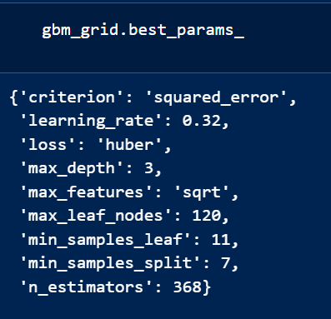
Machine learning model
GradientBoostingRegressor
Beste performance in vorig project
Gebruikt clean dataset

Slide 4
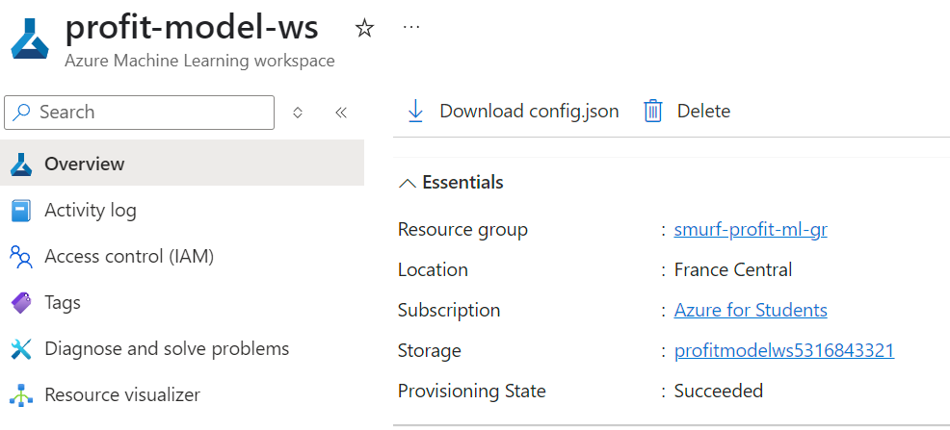
Azure ML Setup (Task 1)
Resource group: smurf-profit-ml-gr
Workspace: profit-model-ws
Computes: cc-profit-train, ci-profit-dev
Registered cleaned dataset
App Registration voor GitHub: github-ml-pipeline

Slide 5
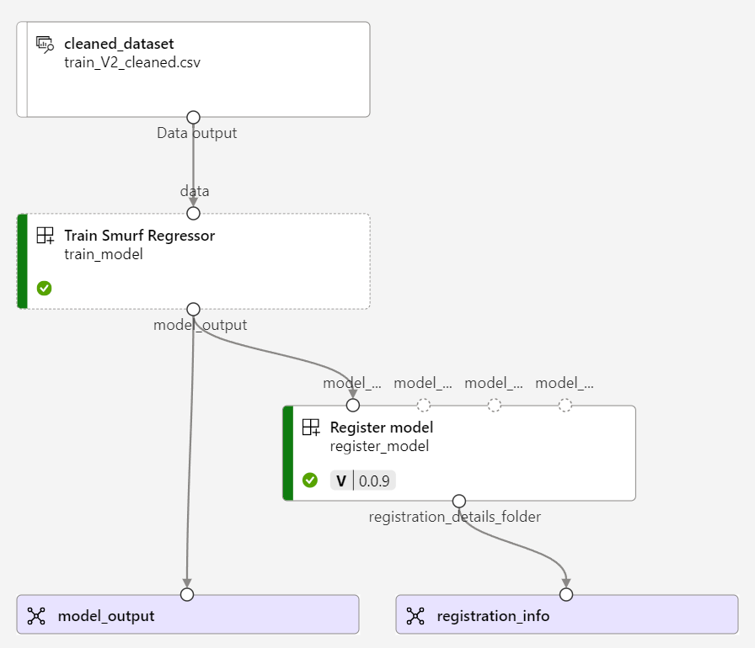
Azure ML Setup (Task 1)
smurf-train-env.yaml: environment definition for dependencies
az ml environment create --file profit-predictor/smurf-train-env.yaml
pipeline.yaml: defines the whole pipeline
train_regressor.yaml: describes the training component
train.py: actual Python script that trains the model
az ml job create --file pipeline.yaml

Slide 6
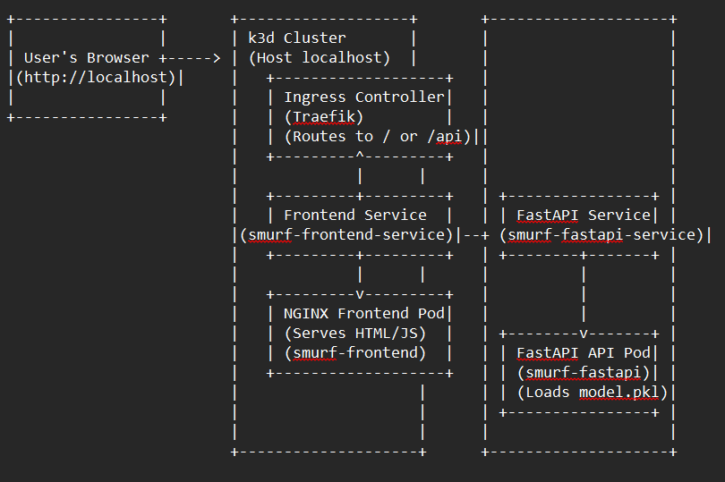
FastAPI & Kubernetes (Task 2)
Key components of Kubernetes:
Fastapi endpoint
Frontend
Prod ready webserver/reverse proxy

Slide 7
Overall flow
User requests -> Ingress -> Frontend/API -> Model Inference.

Slide 8
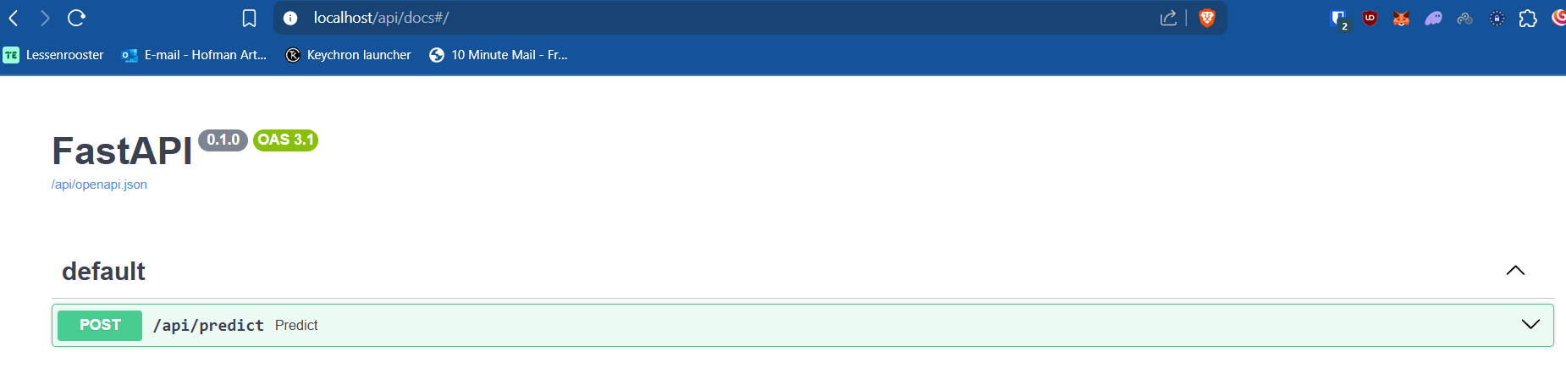
Fastapi API endpoint
Encapsulates model
Provides /api/docs
Proveds /api/predict (POST) for predictions
Uses uvicorn, python, FastApi

Slide 9
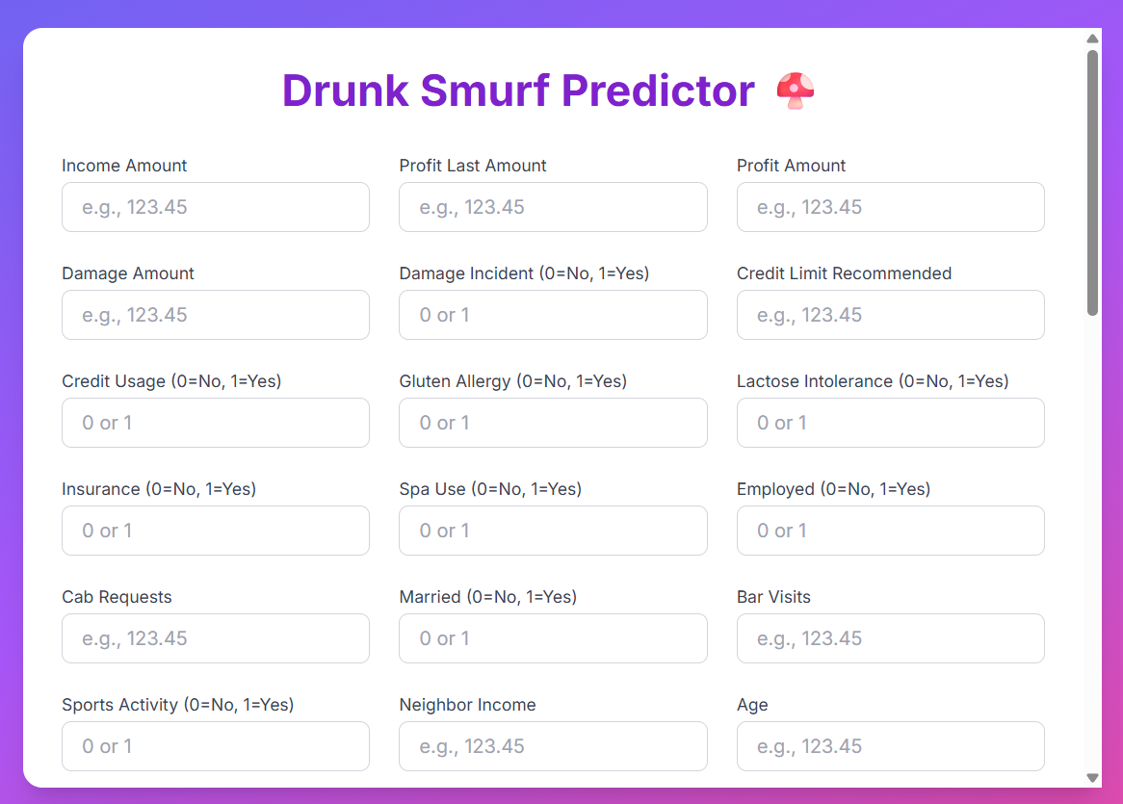
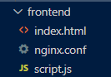
Frontend
Simple static site and js
Tailwind CSS

Slide 10
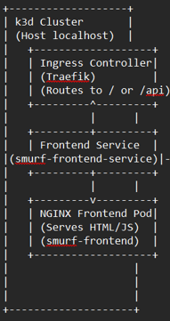
Production ready webserver/reverse proxy NGINX
Static file serving (webpage)
INGRESS: External to service
NGINX: Internal, static files

Slide 11
Kubernetes deployment, why?
Makes deployment easy
Easy to scale (e.g. more fastapi replicas)
High availability (auto restarts)
Rolling updates (zero downtime)
Environment consistency

Slide 12
Our kubernetes setup
1 server (duh)
2 agents
Agent 1 ‘Frontend’: NGINX and static webfiles (in docker image)
Agent 2 ‘Backend’: FastAPI and model (in docker image)

Slide 13
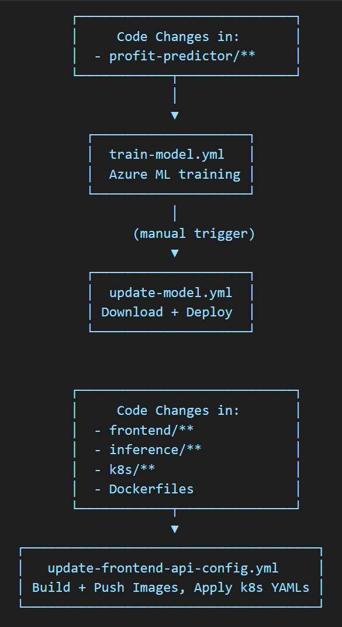
Automation (Task 3)
GitHub Actions
train-model.yml: retrains model on Azure ML
update-model.yml: deploys the latest trained model
update-frontend-api-config.yml: redeploys frontend, backend, and config changes

Slide 14
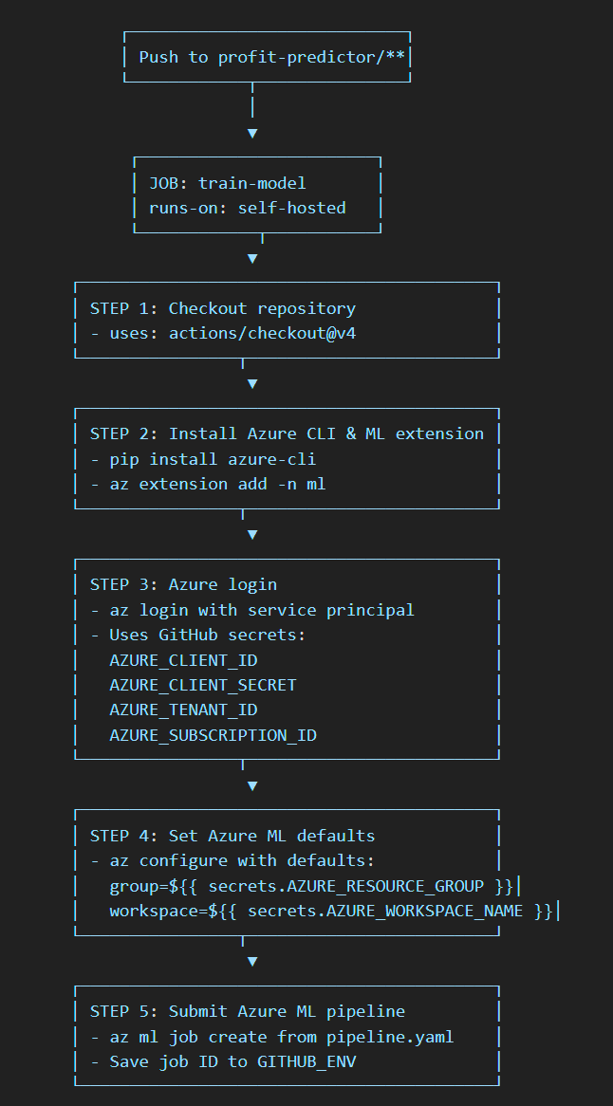
train-model.yml – Automatic Retraining
Trigger: Code changes in profit-predictor/**
Action steps
Authenticate with Azure ML (using secrets)
Submit training pipeline
Register model as smurf-regressor

Slide 15
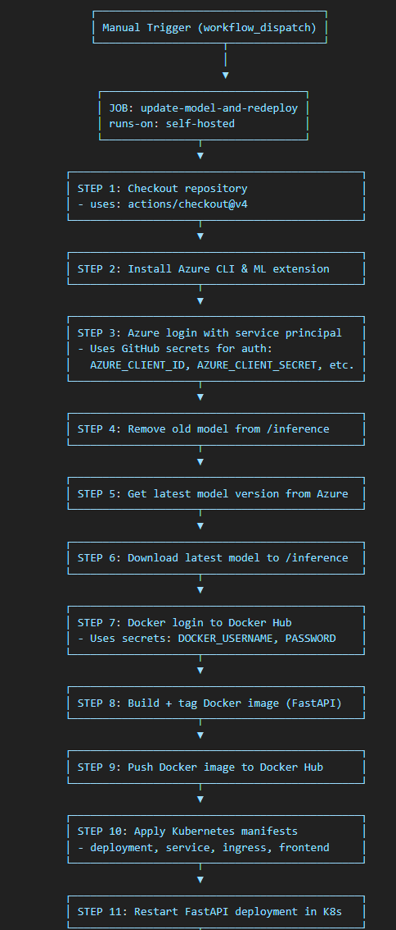
update-model.yml – Deploy Latest Model
Trigger: Manual (workflow_dispatch)
Steps:
Login to Azure ML
Download newest model
Replace old model in inference/
Rebuild + push Docker image
Restart FastAPI deployment

Slide 16
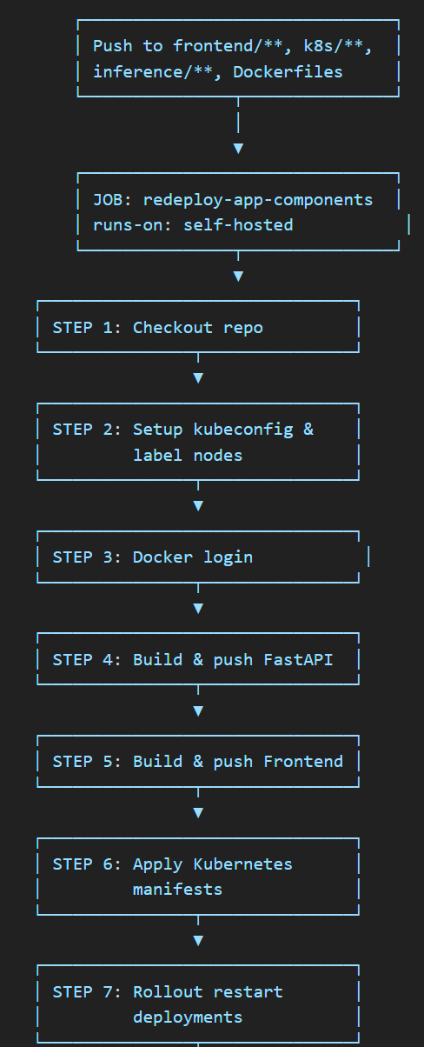
update-frontend-api-config.yml – Redeploy Everything
Trigger: Code changes in:
frontend/**, inference/**, k8s/**, Dockerfile
Steps:
Build new Docker images
Push to Docker Hub
Apply k8s manifests
Rollout restart (zero-downtime)

Slide 17
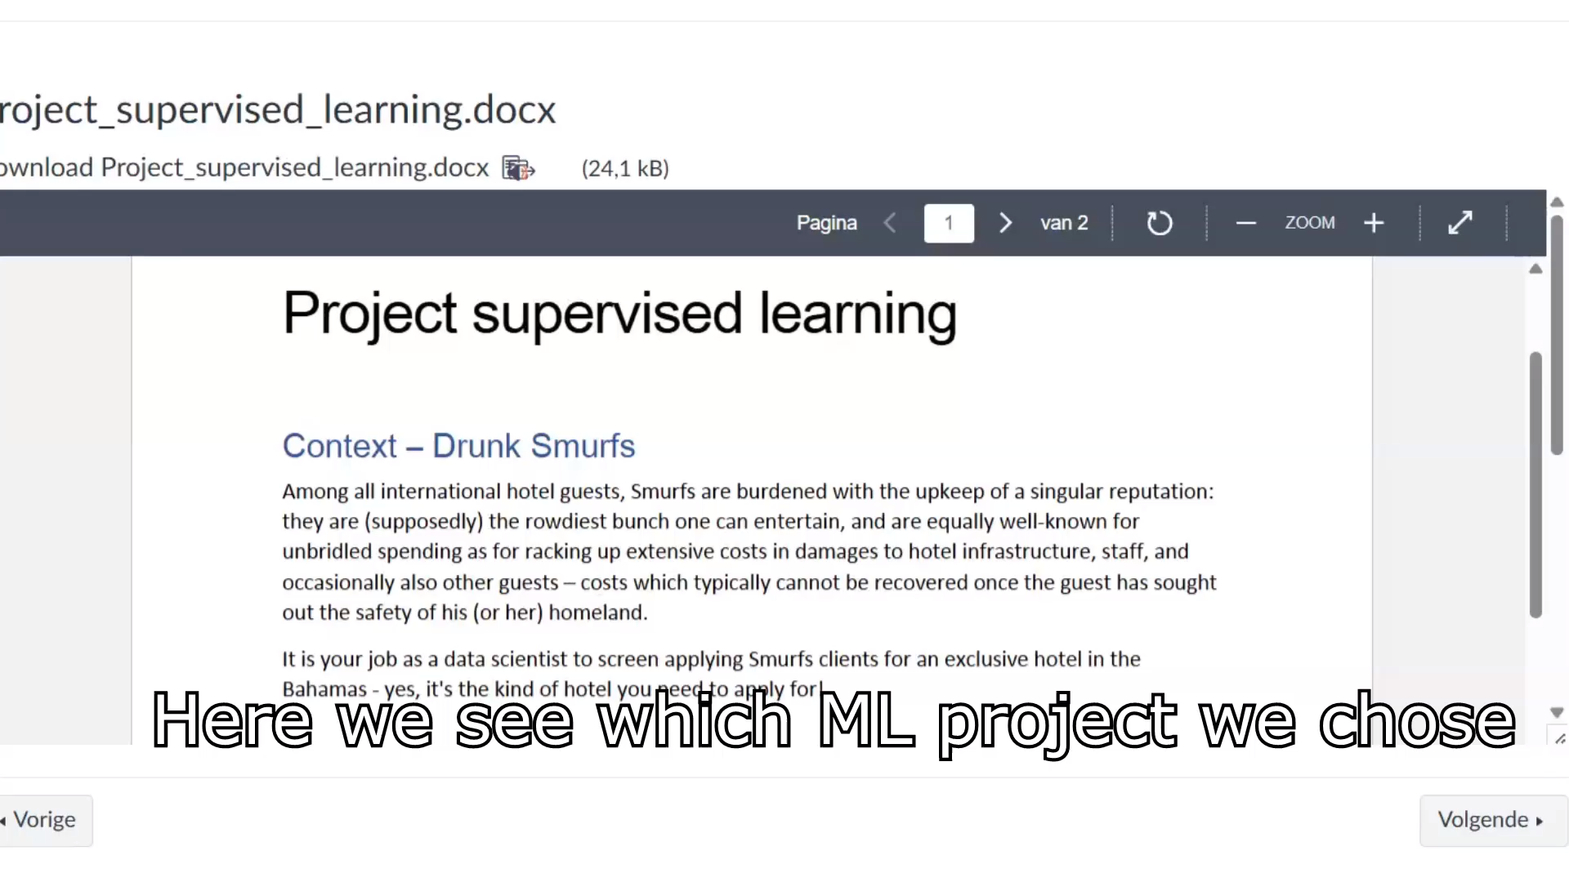
Demo & Result

Slide 18
Challenges, Learnings & Reflection

Slide 19
Einde
Zijn er nog vragen?

